Slide 1


Modern Operating Systems
Fifth Edition
Chapter 6
Deadlocks
Copyright © 2023, 2014, 2008 Pearson Education, Inc. All Rights Reserved
Notes:
If this PowerPoint presentation contains mathematical equations, you may need to check that your computer has the following installed:
1) Math Type Plugin
2) Math Player (free versions available)
3) NVDA Reader (free versions available)

Slide 2
Overview (1 of 6)
Deadlock definition and modeling
Deadlock detection
Deadlock avoidance
Deadlock prevention
Deadlock handling in practice

Slide 3
Overview (2 of 6)
Deadlock definition and modeling
Deadlock detection
Deadlock avoidance
Deadlock prevention
Deadlock handling in practice

Slide 4
Using Resources
Sequence of events required to use a resource (e.g., disk)
Request the resource
Use the resource
Release the resource

Slide 5
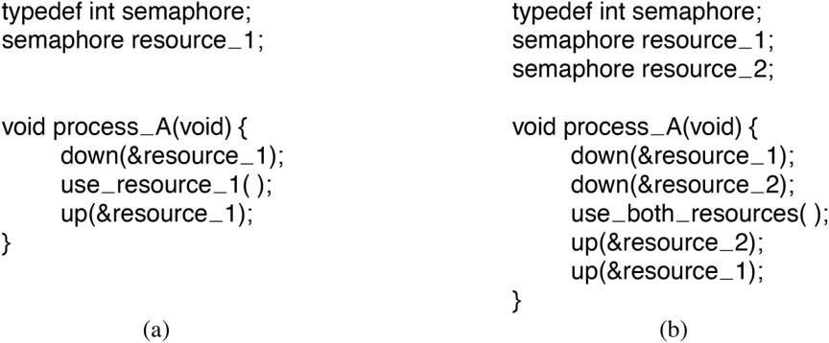
Resource Acquisition (1)
Figure 6.1 Using a semaphore to protect resources. (a) One resource. (b) Two resources.
Notes:
Long Description:
The 7 lines of code for figure (a) are as follow
typedef int semaphore semicolon
semaphore resource underscore 1 semicolon
void process underscore A open parenthesis void close parenthesis open curly bracket
down open parenthesis ampersand resource underscore 1 close parenthesis semicolon
use underscore resource underscore 1 open close parenthesis semicolon
up open parenthesis ampersand resource underscore 1 close parenthesis semicolon
close curly bracket
The 10 lines of code for figure (b) are as follow
typedef int semaphore semicolon
semaphore resource underscore 1 semicolon
semaphore resource underscore 2 semicolon
void process underscore A open parenthesis void close parenthesis open curly bracket
down open parenthesis ampersand resource underscore 1 close parenthesis semicolon
down open parenthesis ampersand resource underscore 2 close parenthesis semicolon
use underscore both underscore resources open parenthesis close parenthesis semicolon
up open parenthesis ampersand resource underscore 2 close parenthesis semicolon
up open parenthesis ampersand resource underscore 1 close parenthesis semicolon
close curly bracket

Slide 6
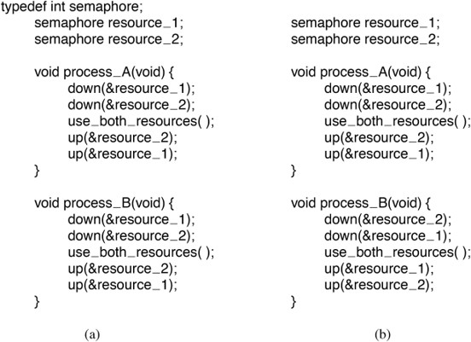
Resource Acquisition (2)
Figure 6.2 (a) Deadlock-free code. (b) Code with a potential deadlock.
Notes:
Long Description:
The 17 lines of code for figure (a) are as follow
typedef int semaphore semicolon
semaphore resource underscore 1 semicolon
semaphore resource underscore 2 semicolon
void process underscore A open parenthesis void close parenthesis open curly bracket
down open parenthesis ampersand resource underscore 1 close parenthesis semicolon
down open parenthesis ampersand resource underscore 2 close parenthesis semicolon
use underscore both underscore resources open close parenthesis semicolon
up open parenthesis ampersand resource underscore 2 close parenthesis semicolon
up open parenthesis ampersand resource underscore 1 close parenthesis semicolon
close curly bracket
void process underscore B open parenthesis void close parenthesis open curly bracket
down open parenthesis ampersand resource underscore 1 close parenthesis semicolon
down open parenthesis ampersand resource underscore 2 close parenthesis semicolon
use underscore both underscore resources open close parenthesis semicolon
up open parenthesis ampersand resource underscore 2 close parenthesis semicolon
up open parenthesis ampersand resource underscore 1 close parenthesis semicolon
close curly bracket
The 16 lines of code for figure (b) are as follow
semaphore resource underscore 1 semicolon
semaphore resource underscore 2 semicolon
void process underscore A open parenthesis void close parenthesis open curly bracket
down open parenthesis ampersand resource underscore 1 close parenthesis semicolon
down open parenthesis ampersand resource underscore 2 close parenthesis semicolon
use underscore both underscore resources open close parenthesis semicolon
up open parenthesis ampersand resource underscore 2 close parenthesis semicolon
up open parenthesis ampersand resource underscore 1 close parenthesis semicolon
close curly bracket
void process underscore B open parenthesis void close parenthesis open curly bracket
down open parenthesis ampersand resource underscore 2 close parenthesis semicolon
down open parenthesis ampersand resource underscore 1 close parenthesis semicolon
use underscore both underscore resources open close parenthesis semicolon
up open parenthesis ampersand resource underscore 1 close parenthesis semicolon
up open parenthesis ampersand resource underscore 2 close parenthesis semicolon
close curly bracket

Slide 7
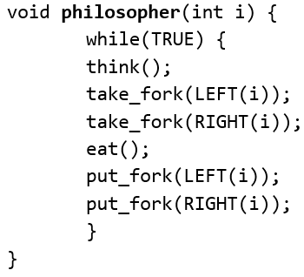
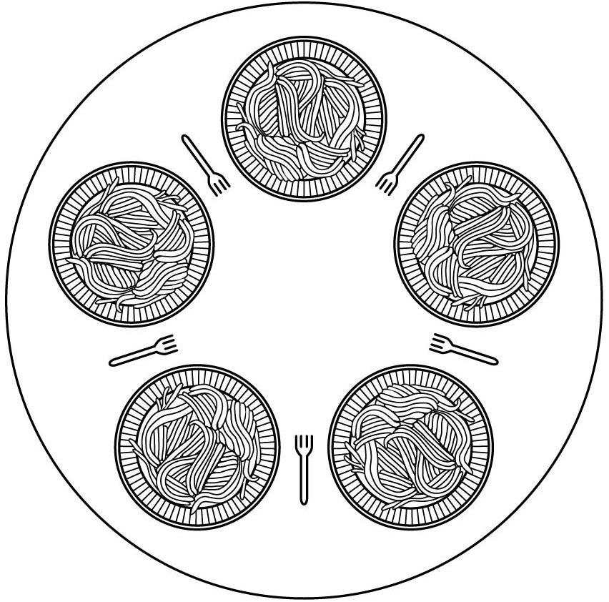
The Dining Philosophers Problem (1)
There are 5 philosophers, each seated at a round table in front of a plate of spaghetti. A philosopher needs 2 forks to eat the spaghetti, located on his left and his right.
Obvious (non)solution:
Notes:
Long Description:
The code from top to bottom reads as follows. Void philosopher left parenthesis int i right parenthesis left brace; while left parenthesis true right parenthesis left brace; think left parenthesis right parenthesis; take underscore fork left parenthesis left left parenthesis i right parenthesis right parenthesis semicolon; take underscore fork left parenthesis right left parenthesis i right parenthesis right parenthesis semicolon; eat left parenthesis right parenthesis semicolon; put underscore fork left parenthesis left left parenthesis i right parenthesis right parenthesis semicolon; put underscore fork left parenthesis right left parenthesis i right parenthesis right parenthesis semicolon; right brace; right brace.

Slide 8
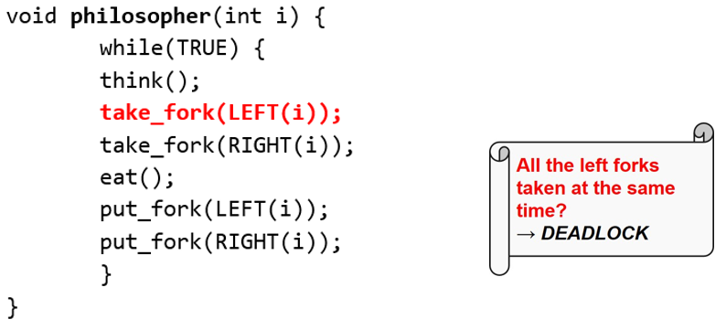
The Dining Philosophers Problem (2)
There are 5 philosophers, each seated at a round table in front of a plate of spaghetti. A philosopher needs 2 forks to eat the spaghetti, located on his left and his right.
Obvious (non)solution:
Notes:
Long Description:
The code from top to bottom reads as follows. Void philosopher left parenthesis int i right parenthesis left brace; while left parenthesis true right parenthesis left brace; think left parenthesis right parenthesis; take underscore fork left parenthesis left left parenthesis i right parenthesis right parenthesis semicolon; take underscore fork left parenthesis right left parenthesis i right parenthesis right parenthesis semicolon; eat left parenthesis right parenthesis semicolon; put underscore fork left parenthesis left left parenthesis i right parenthesis right parenthesis semicolon; put underscore fork left parenthesis right left parenthesis i right parenthesis right parenthesis semicolon; right brace; right brace. On the left, an illustration of a scroll with the text that reads as follows. All the left forks taken at the same time question right arrow deadlock.

Slide 9
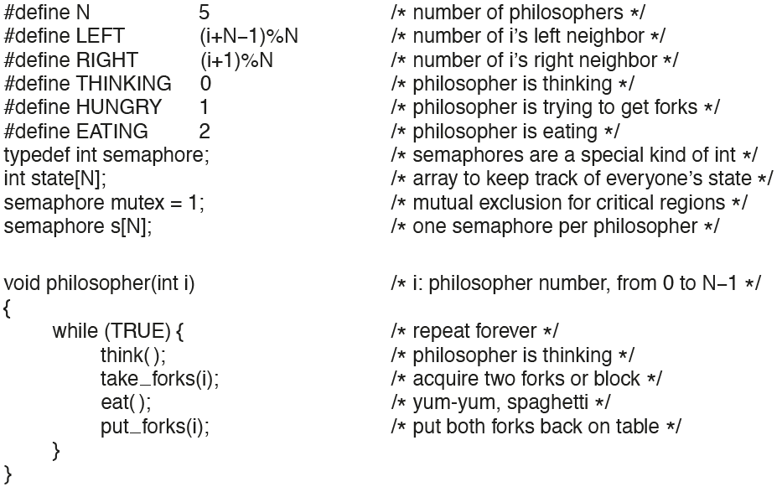
The Dining Philosophers Problem (3)
Figure 6.5 A solution to the dining philosophers problem.
Notes:
Long Description:
The code from top to bottom reads as follows. Hashtag define N 5 forward slash asterisk number of philosopher asterisk forward slash; hashtag define left left parenthesis i plus N minus 1 right parenthesis modulus N forward slash asterisk number of i’s left neighbor asterisk forward slash; hashtag define right left parenthesis i plus 1 right parenthesis modulus N forward slash asterisk number of i’s, right neighbor, asterisk forward slash; hashtag define thinking 0 forward slash asterisk philosopher is thinking asterisk forward slash; hashtag define hungry 1 forward slash asterisk philosopher is trying to get forks asterisk forward slash; hashtag define eating 2 forward slash asterisk philosopher is eating asterisk forward slash; type d e f int semaphore semicolon forward slash asterisk semaphores are a special kind of int asterisk forward slash; Int state left bracket N right bracket semicolon forward slash array to keep track of everyone’s state asterisk forward slash; semaphore mutex equals 1 semicolon forward slash asterisk Mutual exclusion for of everyone’s regions asterisk forward slash; semaphore s left bracket N right bracket semicolon forward slash asterisk one semaphore per philosopher asterisk forward slash; void philosophers left parenthesis int i right parenthesis forward slash asterisk i colon philosopher number comma from 0 to N minus 1 asterisk forward slash; left brace; while left parenthesis true right parenthesis left brace forward slash repeat forever asterisk forward slash; think left parenthesis right parenthesis semicolon forward slash philosopher is thinking asterisk forward slash; take underscore forks left parenthesis i right parenthesis semicolon forward slash acquire two forks or block asterisk forward slash; eat left parenthesis right parenthesis semicolon forward slash asterisk yum-yum comma spaghetti asterisk forward slash; put underscore forks left parenthesis i right parenthesis semicolon forward slash put both forks back on table asterisk forward slash; right brace; right brace.

Slide 10
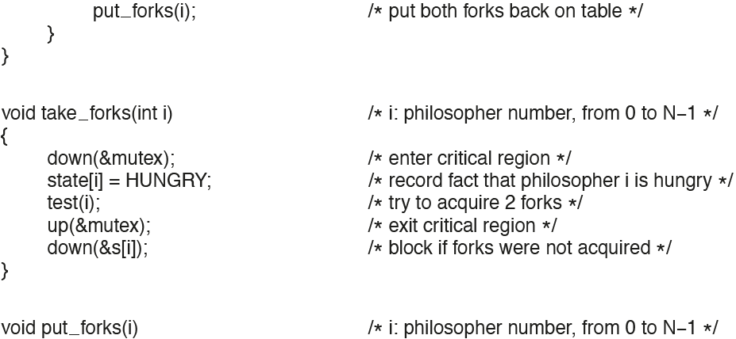
The Dining Philosophers Problem (4)
Figure 6.5 A solution to the dining philosophers problem.
Notes:
Long Description:
The code from top to bottom reads as follows. Put underscore forks left parenthesis i right parenthesis forward slash asterisk put both forks back on table asterisk forward slash; right brace; right brace; void take underscore forks left parenthesis int i right parenthesis forward slash asterisk i colon philosopher number comma from 0 to N minus 1 asterisk forward slash; left brace; down left parenthesis and mutex right parenthesis semicolon forward slash asterisk enter the critical region asterisk forward slash; state left bracket i right bracket equals hungry semicolon forward slash asterisk record fact that philosopher i is hungry asterisk forward slash; test left parenthesis i right parenthesis semicolon forward slash asterisk try to acquire 2 forks asterisk forward slash; up left parenthesis and mutex end parenthesis semicolon forward slash asterisk exit critical region asterisk forward slash; down left parenthesis and s left brace i right brace end parenthesis semicolon forward slash asterisk block if forks were not acquired asterisk forward slash; right brace; void put underscore forks left parenthesis i right parenthesis forward slash asterisk i colon philosopher number comma from 0 to N minus 1 asterisk forward slash.

Slide 11
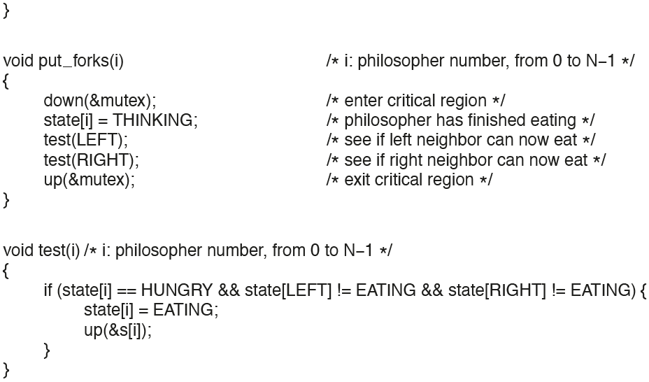
The Dining Philosophers Problem (5)
Figure 6.5 A solution to the dining philosophers problem.
Notes:
Long Description:
The code from top to bottom reads as follows. Void put underscore forks left parenthesis i right parenthesis forward slash asterisk i colon philosopher number comma from 0 to N minus 1 asterisk forward slash; left brace; down left parenthesis and mutex right parenthesis semicolon forward slash asterisk enter critical region asterisk forward slash; state left bracket i right bracket equals thinking semicolon forward slash asterisk philosopher has finished eating asterisk forward slash; test left parenthesis left right parenthesis semicolon forward slash asterisk see if left neighbor can now eat asterisk forward slash; test left parenthesis right right parenthesis semicolon forward slash asterisk see if right neighbor can now eat asterisk forward slash; up left parenthesis and mutex right parenthesis semicolon forward slash asterisk exit critical region asterisk forward slash; right brace; void test left parenthesis i right parenthesis forward slash asterisk i colon philosopher number comma from 0 to N minus 1 asterisk forward slash; left brace; if left parenthesis state left bracket i right bracket double equals hungry and and state left bracket left right bracket exclamation mark equals eating and and state right bracket right right bracket exclamation equals eating right parenthesis left brace; state left bracket i right bracket equals eating semicolon; up left parenthesis and s left bracket i right bracket right parenthesis semicolon; right bracket; right brace.

Slide 12
Resource Deadlocks: Examples
Dining Philosophers: Everybody starts by taking the left fork
Four cars arrive simultaneously at a junction and each yields to the car on the right
Process A opens file #1 and tries to open file #2. File #2 is currently opened by Process B and Process B waits for file #1

Slide 13
Deadlock Definition
A set of processes is deadlocked if
Each process in the set waiting for an event
That event can be caused only by another process
Other issues:
Starvation?
Livelock?

Slide 14
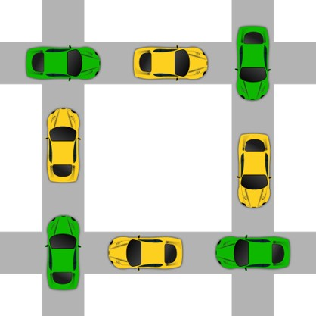
Deadlock
Nothing flows, everything hangs

Slide 15
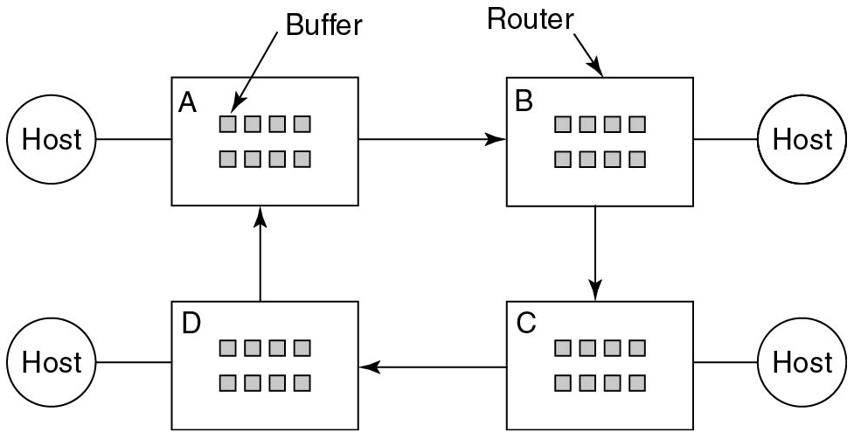
Communication Deadlock
Figure 6.18 A resource deadlock in a network.
Notes:
Long Description:
The figure shows a host connected to a block labeled A containing eight buffers. An arrow from the A block points toward block B containing eight routers. The block B is connected to host.
Similarly a block labeled D and C containing routers and buffers are also connected to two hosts. The block B points to block C, which points to block D, which points back to A.

Slide 16
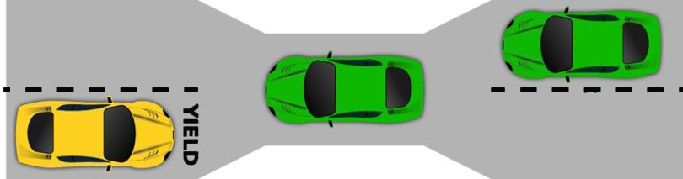
Starvation
Resource: The narrow bridge
Access: Traffic from the right (the yellow car) has right of way
Deadlock resolution: Cars back up (preemption & rollback)
Starvation is possible

Slide 17
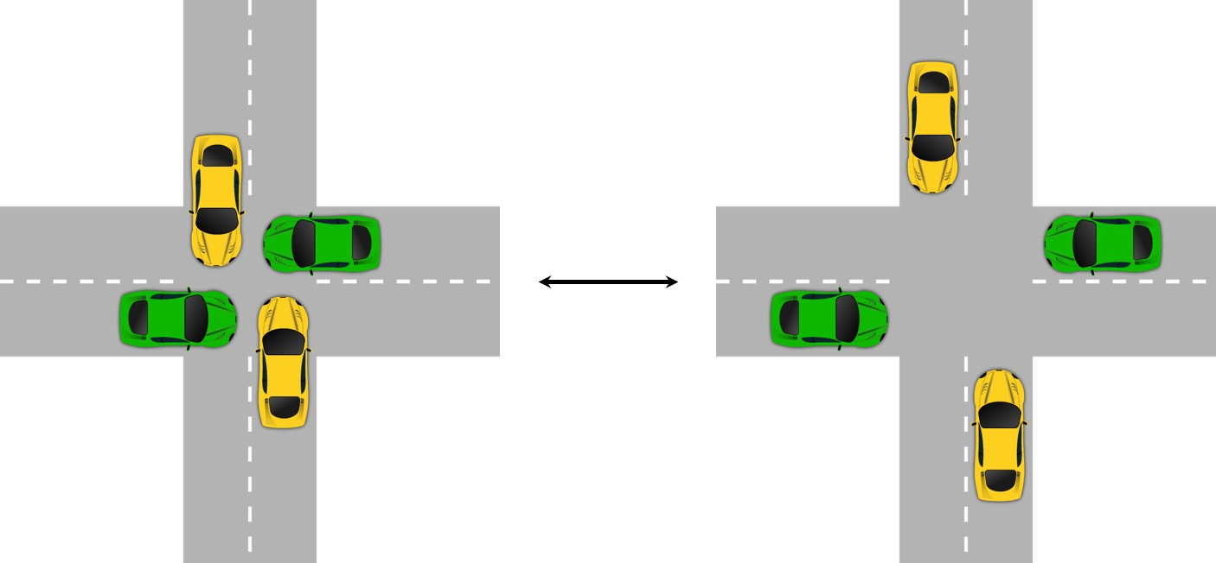
Livelock (1 of 2)
Many operations executed, but no progress

Slide 18
Conditions for Resource Deadlocks
Four conditions that must hold:
Mutual exclusion
Each resource is assigned to at most one process
Hold and wait
Processes can request a resource when holding another one
No preemption
Resources cannot be taken away from a process
Circular wait condition
Chain of two or more processes must be waiting for a resource held by next process in the chain

Slide 19
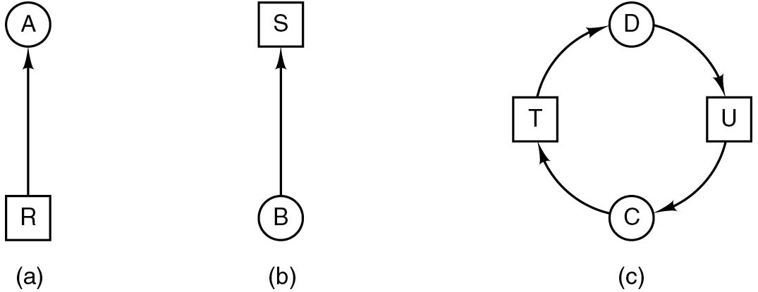
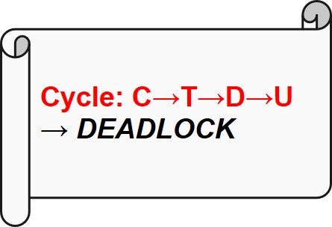
Deadlock Modeling (1)
Figure 6.6 Resource allocation graphs. (a) Holding a resource. (b) Requesting a resource. (c) Deadlock.
Notes:
Long Description1:
Figure a: It contains a square block labeled R pointed vertically upward to a circle labeled A.
Figure b: It contains a circle labeled B pointed vertically upward to a square block labeled S.
Figure c: Here the circle labeled D points toward a block labeled U. The block U points toward a circle labeled C. Again an arrow from C points to a block labeled T. The T block points back to circle D. This forms a circular path.
Long Description2:
The steps for the cycle are as follows. C, T, D, U, and deadlock.

Slide 20
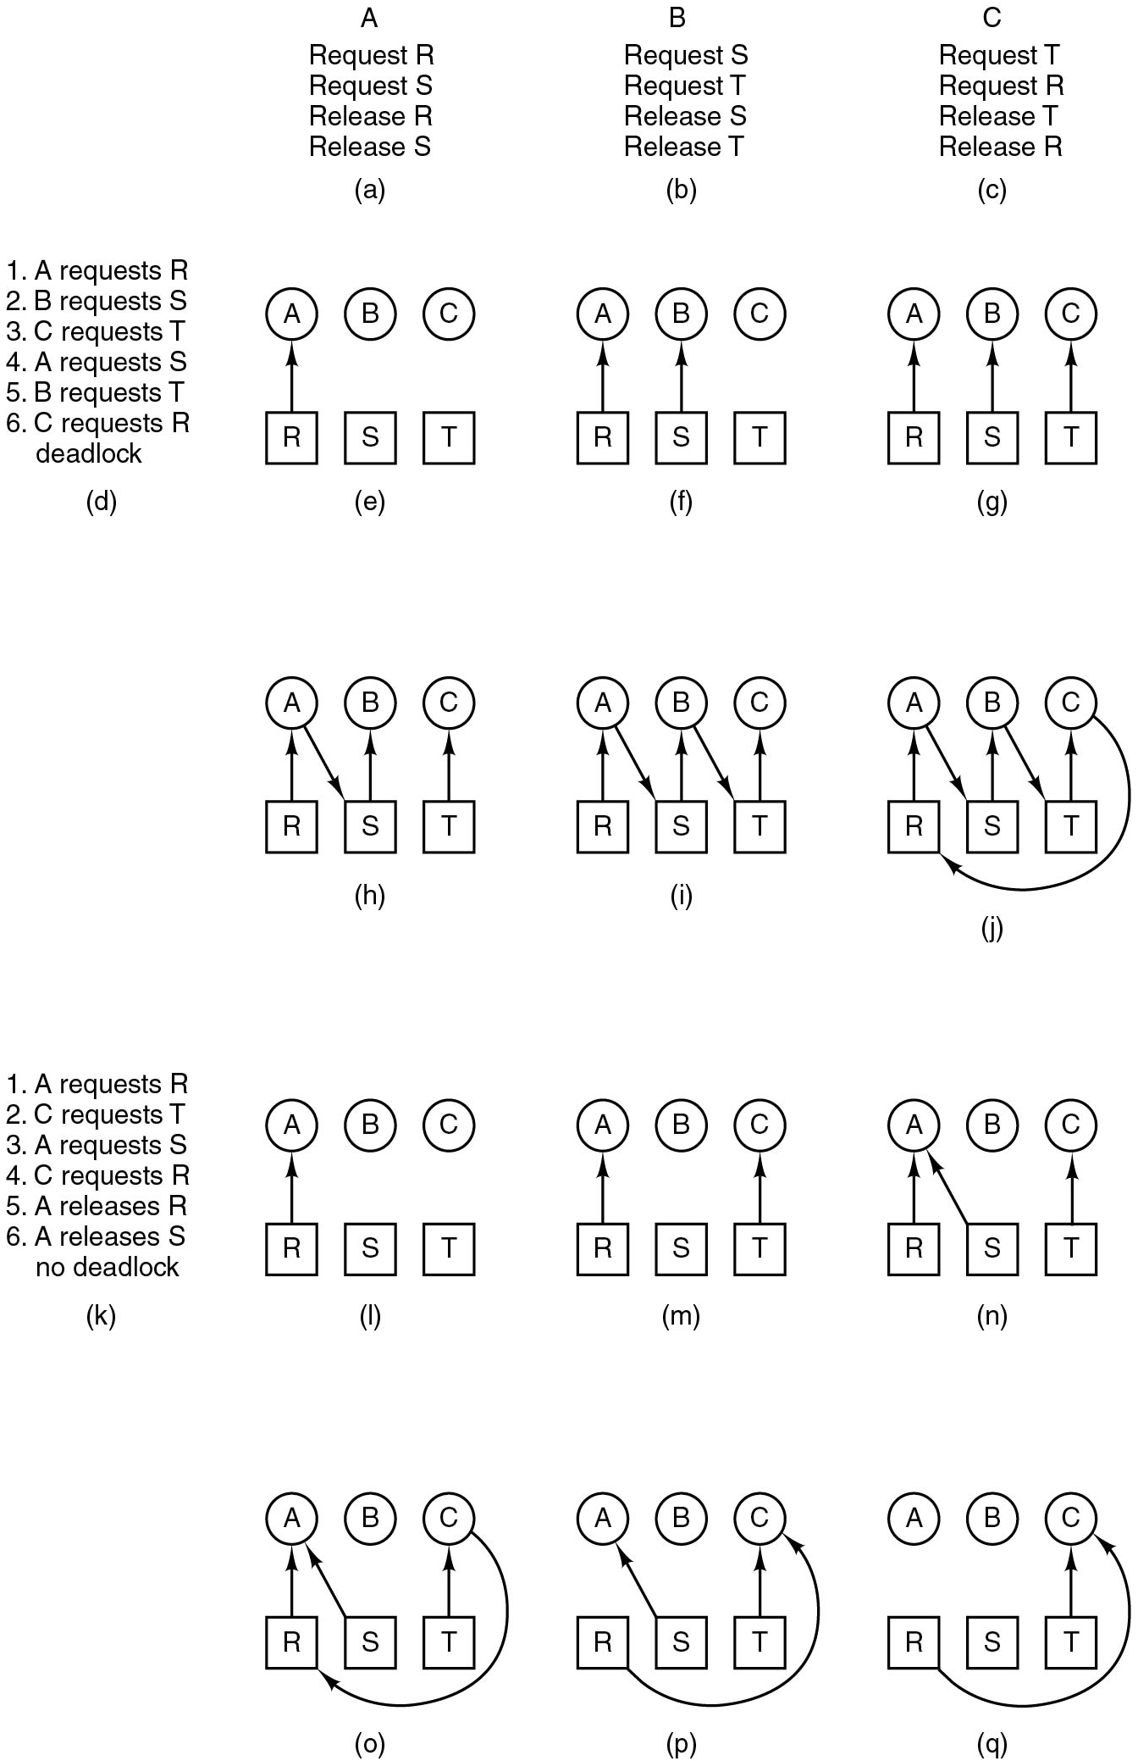
Deadlock Modeling (2)
Figure 6.7 An example of how deadlock occurs and how it can be avoided.
Notes:
Long Description:
Part a is a list labeled a that lists request R, request S, request R, and request S. Part b is a list labeled b that lists request S, request T, request S, and request T. Part c is a list labeled c that lists request T, request R, request T, and request R. Part d is a list labeled d that lists the follows. 1, A request R; 2, B request S; 3, C request T; 4, A requests S; 5, B requests S; 5, B requests T; 6, C requests R; deadlock. Part e, f, and g have three circles labeled A, B, and C; and three squares labeled R, S, T. In part e, an arrow points from R to A. In part f, two arrows points from R to A and S to B. In part g, three arrows points from R to A, S to B, and T to C, respectively.

Slide 21
Deadlock Modeling (3)
Figure 6.7 An example of how deadlock occurs and how it can be avoided.
Notes:
Long Description:
Parts h, i, j, l, m, and n have three circles labeled A, B, and C; and three squares labeled R, S, T. In part h, the arrow points from R to S to B and T to C. In i, R to A to S to B to T to C. Part j, an arrow points from R to A to S to B and T to C to R. In part l, an arrow points from R to A. In part m, two arrows points from R to A and S to B. In part n, three arrows points from R to A, S to B, and T to C, respectively. Part k is a list A request R; 2, C request T; 3, A request S; 4, C requests R; 5, A requests R; 6, A requests S; no deadlock.

Slide 22
Deadlock Modeling (4)
Figure 6.7 An example of how deadlock occurs and how it can be avoided.
Notes:
Long Description:
Parts o, p, and q have three circles labeled A, B, and C; and three squares labeled R, S, T. The arrow orientation is as follows. In part o, R to A, S to A, T to C, and C to R. In part p, S to A, R to C. T to C. In part q, R to C. T to C.

Slide 23
Deadlock Handling
Strategies are used for dealing with deadlocks:
Ignore the problem
No action taken
Deadlock detection
Detect deadlock and perform recovery actions
Deadlock avoidance
Carefully allocate resources to avoid deadlocks
Deadlock prevention
Structurally prevent any of the deadlock conditions

Slide 24
Ignore the Problem
Also known as the ostrich algorithm
Cost-effective solution to deadlocks
Assumes deadlocks are rare
Assumes cost of handling deadlocks is high
Assumes effects of deadlocks are tolerable
Simplest solution to manage system resources, i.e., process table, inode table, swap space, etc.

Slide 25
Overview (3 of 6)
Deadlock definition and modeling
Deadlock detection
Deadlock avoidance
Deadlock prevention
Deadlock handling in practice

Slide 26
Deadlock Detection
Detection
Check for cycles in the resource allocation graph
Track progress and time out
Explicit detection (e.g., O O M)
Useful in practice when simple and efficient detection mechanisms (e.g., progress tracking or explicit detection) along with recovery actions are available

Slide 27
Detecting Cycles with One Resource of Each Type (1)
Example of a system – is it deadlocked?
Process A holds R, wants S
Process B holds nothing, wants T
Process C holds nothing, wants S
Process D holds U, wants S and T
Process E holds T, wants V
Process F holds W, wants S
Process G holds V, wants U

Slide 28
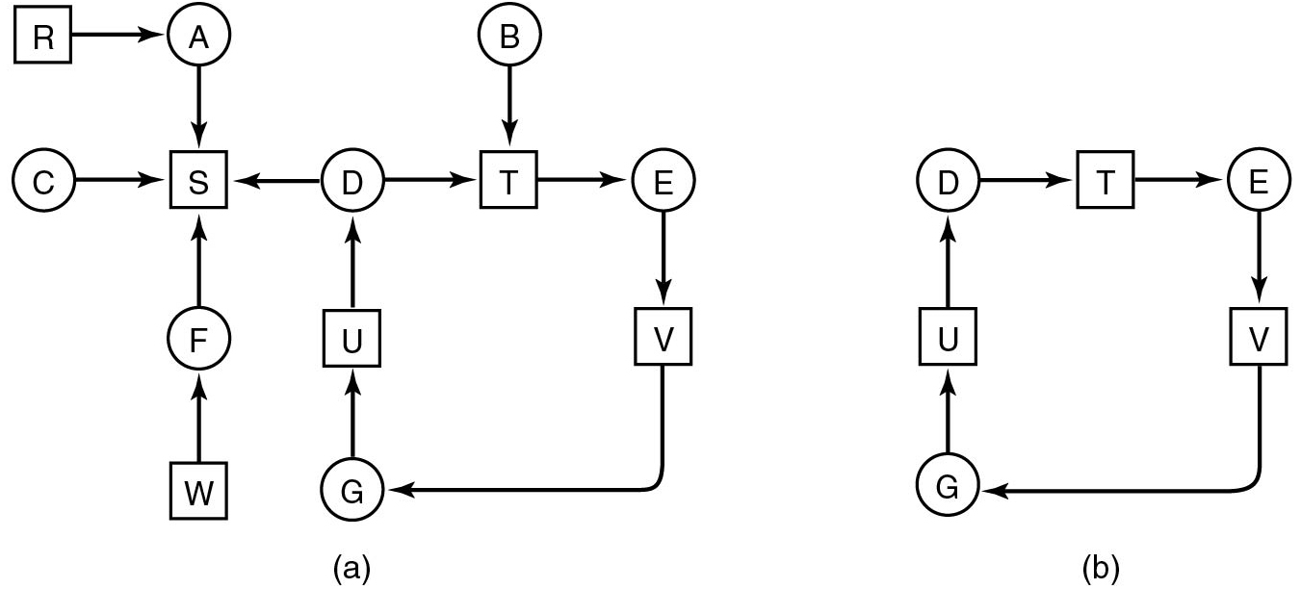
Detecting Cycles with One Resource of Each Type (2)
Figure 6.8 (a) A resource graph. (b) A cycle extracted from (a).
Notes:
Long Description:
Figure a: It is a resource graph. Here a set of nodes are connected randomly as follows. The node R points left to the node A. The node A points down to node S. The node C also points right to node S. The node D points left to node S and right to node T. The node B points down to node T which points right to node E. The node E points down to node V which points down left to node G. The node G points up to node U which again points up to node D. The node W points up to node F which also points up to node S.
Figure b: A cycle extracted from figure a: The same previous connection of nodes D, T, E, V, G and U is shown here.
Note: Here the nodes A, B, D, F, G, C and E are given in circles, and the nodes R, S, U, W, V, and T are given squares.

Slide 29
Algorithm to Detect Cycles (1)
For each node, N in the graph, perform following five steps with N as starting node.
Initialize L to empty list, and designate all arcs as unmarked.
Add current node to end of L, check to see if node now appears in L two times. If so, graph contains a cycle (listed in L) and algorithm terminates

Slide 30
Algorithm to Detect Cycles (2)
From given node, see if there are any unmarked outgoing arcs. If so, go to step 5; if not, go to step 6.
Pick unmarked outgoing arc at random, mark it. Then follow to new current node and go to step 3.
If this is initial node, graph does not contain cycles, algorithm terminates. Otherwise, dead end. Remove it and go back to the previous node.

Slide 31
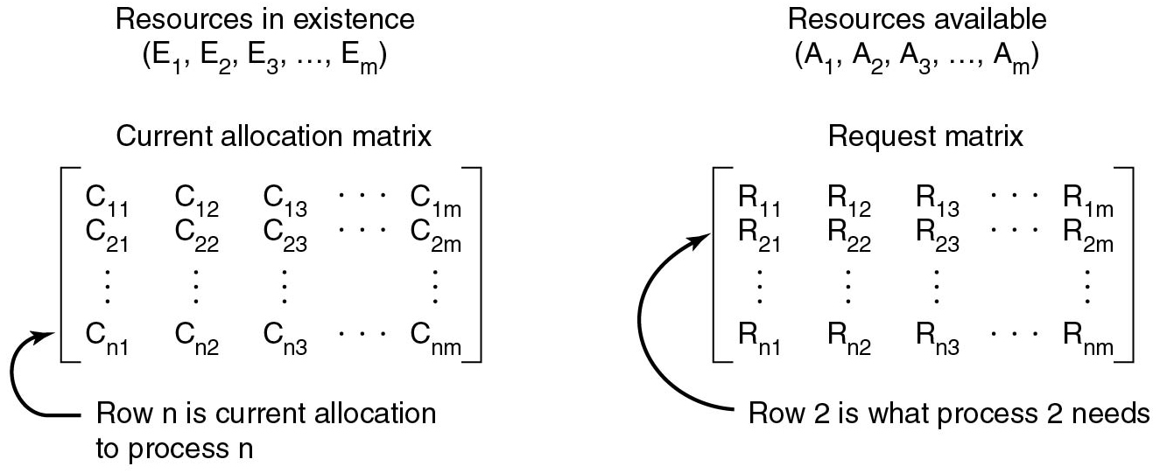
Detecting Cycles with Multiple Resources of Each Type (1 of 3)
Figure 6.9 The four data structures needed by the deadlock detection algorithm.
Notes:
Long Description:
The figure contains four parts.
Part 1: Resources in existence: (E subscript 1, E subscript 2, E subscript 3, upto E subscript m).
Part 2: Resources available: (A subscript 1, A subscript 2, A subscript 3, upto A subscript m).
Part 3: Current allocation matrix: It is a n by m matrix.
StartMatrix
Row 1: C subscript 11, C subscript 12, C subscript 13, upto C subscript 1m.
Row 2: C subscript 21, C subscript 22, C subscript 23, upto C subscript 2m.
Row n: C subscript n1, C subscript n2, C subscript n3, upto C subscript nm.
End Matrix.
An arrow pointing to nth row is labeled row n is current allocation to process n.
Part 4: Request matrix: It is also an n by m matrix.
StartMatrix
Row 1: R subscript 11,R subscript 12, R subscript 13, upto R subscript 1m.
Row 2: R subscript 21, R subscript 22, R subscript 23, upto R subscript 2m.
Row n: R subscript n1, R subscript n2, R subscript n3, upto R subscript nm.
End Matrix.
An arrow pointing to the second row is labeled Row 2 is what process 2 needs.

Slide 32
Detecting Cycles with Multiple Resources of Each Type (2 of 3)
Deadlock detection algorithm:
Look for unmarked process, P i, for which the i-th row of R is less than or equal to A.
If such a process is found, add the i-th row of C to A, mark the process, go back to step 1.
If no such process exists, the algorithm terminates.

Slide 33
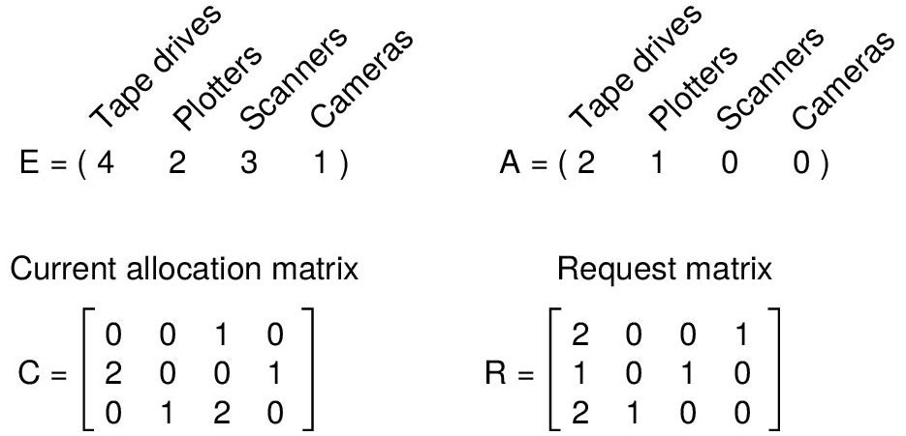
Detecting Cycles with Multiple Resources of Each Type (3 of 3)
Figure 6.10 An example for the deadlock detection algorithm.
Notes:
Long Description:
Part 1: E equals (4 2 3 1), where 4 represents Tape drives, 2 represents Plotters, 3 represents Scanners and 1 represents blue rays.
Part 2: E equals (2 1 0 0), where 2 represents Tape drives, 1 represents Plotters, 0 represents Scanners and 0 represents blue rays.
Part 3: It is a 4 by 3 matrix labeled current allocation matrix. The matrix is given as follows.
C equals StartMatrix, Row 1: 0 0 1 0. Row 2: 2 0 0 1. Row 3: 0 1 2 0 EndMatrix.
Part 3: It is a 4 by 3 matrix labeled request matrix. The matrixis as follows.
R equals StartMatrix, Row 1: 2 0 0 1. Row 2: 1 0 1 0. Row 3: 2 1 0 0.

Slide 34
Recovery from Deadlock
Possible Methods of recovery (though none are “attractive”):
Force preemption
Checkpoint-rollback
Killing the offending processes

Slide 35
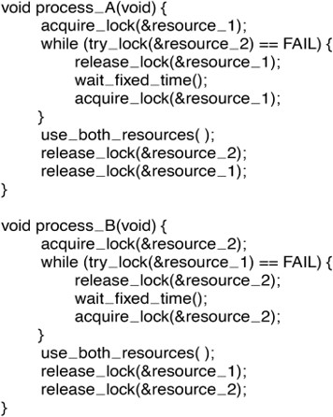
Livelock (2 of 2)
Figure 6.19 Busy waiting that can lead to livelock.
Notes:
Computer code has 7 lines. The lines read as follows. Line 1. Void process underscore A left parenthesis void right parenthesis left brace. Line 2, indented once. acquire underscore lock left parenthesis ampersand resource underscore 1 right parenthesis semicolon. Line 3, indented once. Enter underscore region left parenthesis ampersand resource underscore 2 right parenthesis semicolon. Line 4, indented once. Use underscore both underscore resources left parenthesis right parenthesis semicolon. Line 5, indented once. Leave underscore region left parenthesis ampersand resource underscore 2 right parenthesis semicolon. Line 6, indented once. Leave underscore region left parenthesis ampersand resource underscore 1 right parenthesis semicolon. Line 7. Right brace.
Long Description:
The 22 lines of code are as follow void process underscore A open parenthesis void close parenthesis open curly bracket acquire underscore lock open parenthesis ampersand resource underscore 1 close parenthesis semicolon while open parenthesis try underscore lock open parenthesis ampersand resource underscore 2 close parenthesis equals to equals to FAIL close parenthesis open curly bracket release underscore lock open parenthesis ampersand resource underscore 1 close parenthesis semicolon wait underscore fixed underscore time open close parenthesis semicolon acquire underscore lock open parenthesis ampersand resource underscore 1 close parenthesis semicolon close curly bracket use underscore both underscore resources open close parenthesis semicolon release underscore lock open parenthesis ampersand resource underscore 2 close parenthesis semicolon release underscore lock open parenthesis ampersand resource underscore 1 close parenthesis semicolon close curly bracket void process underscore B open parenthesis void close parenthesis open curly bracket acquire underscore lock open parenthesis ampersand resource underscore 2 close parenthesis semicolon while open parenthesis try underscore lock open parenthesis ampersand resource underscore 1 close parenthesis equals to equals to FAIL close parenthesis open curly bracket release underscore lock open parenthesis ampersand resource underscore 2 close parenthesis semicolon wait underscore fixed underscore time open close parenthesis semicolon acquire underscore lock open parenthesis ampersand resource underscore 2 close parenthesis semicolon close curly bracket use underscore both underscore resources open close parenthesis semicolon release underscore lock open parenthesis ampersand resource underscore 1 close parenthesis semicolon release underscore lock open parenthesis ampersand resource underscore 2 close parenthesis semicolon close curly bracket

Slide 36
Overview (4 of 6)
Deadlock definition and modeling
Deadlock detection
Deadlock avoidance
Deadlock prevention
Deadlock handling in practice

Slide 37
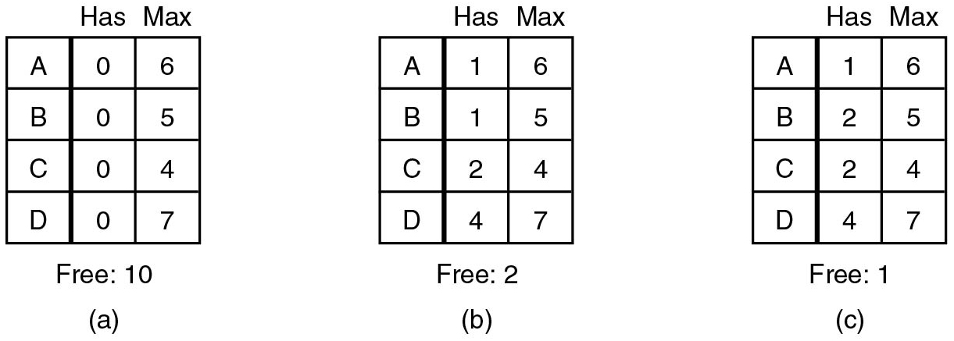
Deadlock Avoidance: Single Resource (1 of 4)
Banker’s algorithm (Dijkstra):
Customers (processes) request credits (resources)
Banker (O S) only satisfies requests resulting in safe states
A state is safe iff there exists a sequence of other states that allows all the customers to complete
Maximum credit demands are known in advance
Notes:
Long Description:
The figure a to c consists of a block divided into four rows and three columns. The column headings are labeled blank, Has, Max.
Figure a: It is labeled Free: 10: The row entries are as follows.
Row 1: blank column, A. Has column, 0. Max column, 6.
Row 2: blank column, B. Has column, 0. Max column, 5.
Row 3: blank column, C. Has column, 0. Max column, 4.
Row 4: blank column, C. Has column, 0. Max column, 7.
Figure b: It is labeled Free: 2: The row entries are as follows.
Row 1: blank column, A. Has column, 1. Max column, 6.
Row 2: blank column, B. Has column, 1. Max column, 5.
Row 3: blank column, C. Has column, 2. Max column, 4.
Row 4: blank column, C. Has column, 4. Max column, 7.
Figure c: It is labeled Free: 1: The row entries are as follows.
Row 1: blank column, A. Has column, 1. Max column, 6.
Row 2: blank column, B. Has column, 2. Max column, 5.
Row 3: blank column, C. Has column, 2. Max column, 4.
Row 4: blank column, C. Has column, 4. Max column, 7.

Slide 38
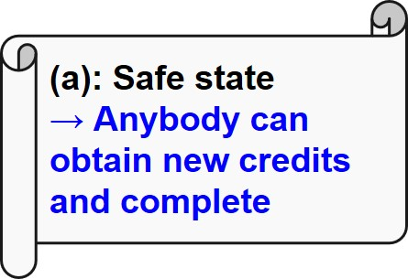
Deadlock Avoidance: Single Resource (2 of 4)
Banker’s algorithm (Dijkstra):
Customers (processes) request credits (resources)
Banker (O S) only satisfies requests resulting in safe states
A state is safe iff there exists a sequence of other states that allows all the customers to complete
Maximum credit demands are known in advance
Notes:
Long Description1:
The figure a to c consists of a block divided into four rows and three columns. The column headings are labeled blank, Has, Max.
Figure a: It is labeled Free: 10: The row entries are as follows.
Row 1: blank column, A. Has column, 0. Max column, 6.
Row 2: blank column, B. Has column, 0. Max column, 5.
Row 3: blank column, C. Has column, 0. Max column, 4.
Row 4: blank column, C. Has column, 0. Max column, 7.
Figure b: It is labeled Free: 2: The row entries are as follows.
Row 1: blank column, A. Has column, 1. Max column, 6.
Row 2: blank column, B. Has column, 1. Max column, 5.
Row 3: blank column, C. Has column, 2. Max column, 4.
Row 4: blank column, C. Has column, 4. Max column, 7.
Figure c: It is labeled Free: 1: The row entries are as follows.
Row 1: blank column, A. Has column, 1. Max column, 6.
Row 2: blank column, B. Has column, 2. Max column, 5.
Row 3: blank column, C. Has column, 2. Max column, 4.
Row 4: blank column, C. Has column, 4. Max column, 7.
Long Description2:
Start parenthesis a end parenthesis colon safe state right arrow anybody can obtain new credits and complete.

Slide 39
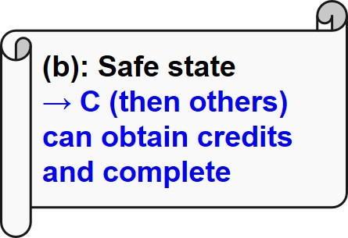
Deadlock Avoidance: Single Resource (3 of 4)
Banker’s algorithm (Dijkstra):
Customers (processes) request credits (resources)
Banker (O S) only satisfies requests resulting in safe states
A state is safe iff there exists a sequence of other states that allows all the customers to complete
Maximum credit demands are known in advance
Notes:
Long Description1:
The figure a to c consists of a block divided into four rows and three columns. The column headings are labeled blank, Has, Max.
Figure a: It is labeled Free: 10: The row entries are as follows.
Row 1: blank column, A. Has column, 0. Max column, 6.
Row 2: blank column, B. Has column, 0. Max column, 5.
Row 3: blank column, C. Has column, 0. Max column, 4.
Row 4: blank column, C. Has column, 0. Max column, 7.
Figure b: It is labeled Free: 2: The row entries are as follows.
Row 1: blank column, A. Has column, 1. Max column, 6.
Row 2: blank column, B. Has column, 1. Max column, 5.
Row 3: blank column, C. Has column, 2. Max column, 4.
Row 4: blank column, C. Has column, 4. Max column, 7.
Figure c: It is labeled Free: 1: The row entries are as follows.
Row 1: blank column, A. Has column, 1. Max column, 6.
Row 2: blank column, B. Has column, 2. Max column, 5.
Row 3: blank column, C. Has column, 2. Max column, 4.
Row 4: blank column, C. Has column, 4. Max column, 7.
Long Description2:
Start parenthesis b end parenthesis colon safe state right arrow C then others can obtain credits and complete.

Slide 40
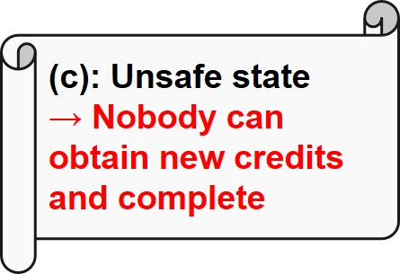
Deadlock Avoidance: Single Resource (4 of 4)
Banker’s algorithm (Dijkstra):
Customers (processes) request credits (resources)
Banker (O S) only satisfies requests resulting in safe states
A state is safe iff there exists a sequence of other states that allows all the customers to complete
Maximum credit demands are known in advance
Notes:
Long Description1:
The figure a to c consists of a block divided into four rows and three columns. The column headings are labeled blank, Has, Max.
Figure a: It is labeled Free: 10: The row entries are as follows.
Row 1: blank column, A. Has column, 0. Max column, 6.
Row 2: blank column, B. Has column, 0. Max column, 5.
Row 3: blank column, C. Has column, 0. Max column, 4.
Row 4: blank column, C. Has column, 0. Max column, 7.
Figure b: It is labeled Free: 2: The row entries are as follows.
Row 1: blank column, A. Has column, 1. Max column, 6.
Row 2: blank column, B. Has column, 1. Max column, 5.
Row 3: blank column, C. Has column, 2. Max column, 4.
Row 4: blank column, C. Has column, 4. Max column, 7.
Figure c: It is labeled Free: 1: The row entries are as follows.
Row 1: blank column, A. Has column, 1. Max column, 6.
Row 2: blank column, B. Has column, 2. Max column, 5.
Row 3: blank column, C. Has column, 2. Max column, 4.
Row 4: blank column, C. Has column, 4. Max column, 7.
Long Description2:
Start parenthesis c end parenthesis colon unsafe state right arrow nobody can obtain new credits and complete.

Slide 41
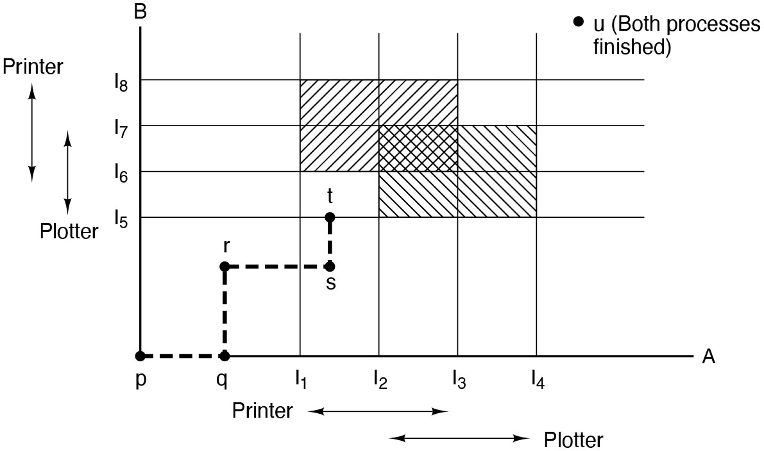
Deadlock Avoidance Resource Trajectories
Figure 6.11. Two process resource trajectories.
Notes:
Long Description:
The horizontal axis represents the number of instructions executed by process A and marked I subscript 1, I subscript 2, I subscript 3, I subscript 4 in equal intervals. The vertical axis represents the number of instructions executed by process B and marked I subscript 5, I subscript 6, I subscript 7, I subscript 8 in equal intervals. The horizontal and vertical axis are also labeled printer and plotter using double headed arrows. A set of vertical and horizontal lines are drawn from the points marked on the horizontal and vertical axesand the the rectangular regions thus formed are shaded except the lower left end and upper right end region. The curve starts at the origin labeled p,moves toward right upto the point q which is at the left mid of horizontal axis, then goes up until the point r which is at the lower mid region of first quadrant, then moves right upto the point s which lies at between the points I subscript 1 and I subscript 2 and finally rises upard upto t which lies at the horizontal lines from I subscript 5 and ends.
A point u is marke don the upper right end of the first quadrnt which represents both processes finished.

Slide 42
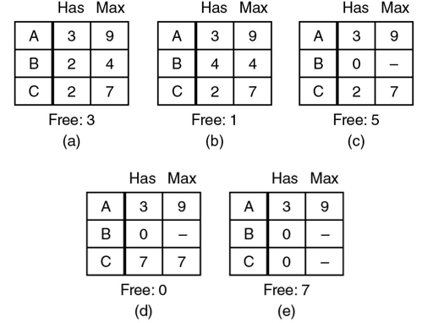
Safe and Unsafe States (1)
Figure 6.12 Demonstration that the state in (a) is safe.
Notes:
Long Description:
The figure a to e consists of a block divided into three rows and three columns. The column headings are labeled blank, Has, Max.
Figure a: It is labeled Free: 3: The row entries are as follows.
Row 1: blank column, A. Has column, 3. Max column, 9.
Row 2: blank column, B. Has column, 2. Max column, 4.
Row 3: blank column, C. Has column, 2. Max column, 7.
Figure b: It is labeled Free: 1: The row entries are as follows.
Row 1: blank column, A. Has column, 3. Max column, 9.
Row 2: blank column, B. Has column, 4. Max column, 4.
Row 3: blank column, C. Has column, 2. Max column, 7.
Figure c: It is labeled Free: 5: The row entries are as follows.
Row 1: blank column, A. Has column, 3. Max column, 9.
Row 2: blank column, B. Has column, 0. Max column, unknown.
Row 3: blank column, C. Has column, 2. Max column, 7.
Figure d: It is labeled Free: 0: The row entries are as follows.
Row 1: blank column, A. Has column, 3. Max column, 9.
Row 2: blank column, B. Has column, 0. Max column, unknown.
Row 3: blank column, C. Has column, 7. Max column, 7.
Figure e: It is labeled Free: 7: The row entries are as follows.
Row 1: blank column, A. Has column, 3. Max column, 9.
Row 2: blank column, B. Has column, 0. Max column, unknown.
Row 3: blank column, C. Has column, 0. Max column, unknown.

Slide 43
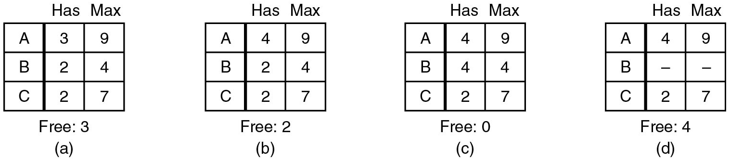
Safe and Unsafe States (2)
Figure 6.13 Demonstration that the state in (b) is not safe.
Notes:
Long Description:
The figure a to d consists of a block divided into three rows and three columns. The column headings are labeled blank, Has, Max.
Figure a: It is labeled Free: 3: The row entries are as follows.
Row 1: blank column, A. Has column, 3. Max column, 9.
Row 2: blank column, B. Has column, 2. Max column, 4.
Row 3: blank column, C. Has column, 2. Max column, 7.
Figure b: It is labeled Free: 2: The row entries are as follows.
Row 1: blank column, A. Has column, 3. Max column, 9.
Row 2: blank column, B. Has column, 2. Max column, 4.
Row 3: blank column, C. Has column, 2. Max column, 7.
Figure c: It is labeled Free: 0: The row entries are as follows.
Row 1: blank column, A. Has column, 4. Max column, 9.
Row 2: blank column, B. Has column, 4. Max column, 4.
Row 3: blank column, C. Has column, 2. Max column, 7.
Figure d: It is labeled Free: 4: The row entries are as follows.
Row 1: blank column, A. Has column, 4. Max column, 9.
Row 2: blank column, B. Has column, unknown. Max column, unknown.
Row 3: blank column, C. Has column, 2. Max column, 7.

Slide 44
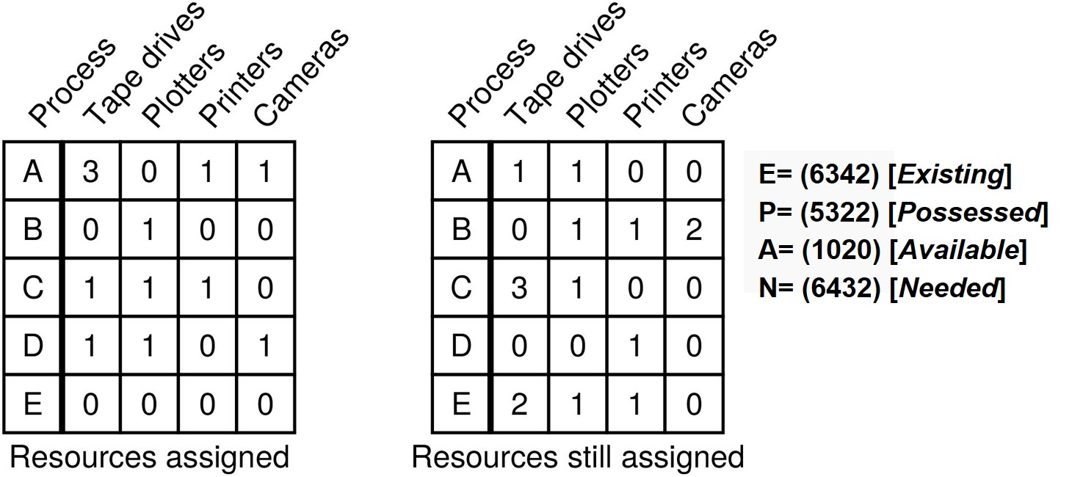
Banker’s Algorithm for Multiple Resources (1)
Figure 6.15 The banker’s algorithm with multiple resources.
Notes:
Long Description:
The column headers are process, tape drivers, plotters, printers, and cameras. The parameters on the right are as follows. E equals left parentheses 6 3 4 2 right parenthesis left bracket existing right bracket. P equals left parenthesis 5 3 2 2 right parenthesis left bracket possessed right bracket. A equals left parentheses 1 0 2 0 right parenthesis left bracket available right bracket. N equals left parentheses 6 3 4 2 right parenthesis left bracket needed right bracket.

Slide 45
Banker’s Algorithm for Multiple Resources (2)
Generalized safe state detection:
Select row R whose unmet resource needs N are all
Mark R as terminated and add its resources to the A vector.
Repeat until completion (safe) or deadlock (unsafe).
Notes:
Long Description:
The column headers are process, tape drivers, plotters, printers, and cameras. The parameters on the right are as follows. E equals left parentheses 6 3 4 2 right parenthesis left bracket existing right bracket. P equals left parenthesis 5 3 2 2 right parenthesis left bracket possessed right bracket. A equals left parentheses 1 0 2 0 right parenthesis left bracket available right bracket. N equals left parentheses 6 3 4 2 right parenthesis left bracket needed right bracket.

Slide 46
Overview (5 of 6)
Deadlock definition and modeling
Deadlock detection
Deadlock avoidance
Deadlock prevention
Deadlock handling in practice

Slide 47
Deadlock Prevention (1 of 2)
Condition | Approach
Mutual exclusion | Spool everything
Hold and wait | Request all resources initially
No preemption | Take resources away
Circular wait | Order resources numerically
Figure 6.17 Summary of approaches to deadlock prevention (negating any of the four deadlock conditions)

Slide 48
Deadlock Prevention (2 of 2)
Mutual exclusion
Spool everything
Typically shifts the problem somewhere else
Hold and wait
Request all resources initially (or reacquire them)
Poor parallelism and resource utilization
No preemption
Take resources away
N/A in many cases (e.g., printer versus memory)
Circular wait
Order resources numerically
Hard to consistently enforce in practice

Slide 49
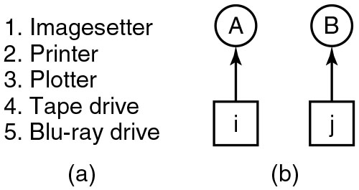
Attacking Circular Wait Condition (1)
Figure 6.16. (a) Numerically ordered resources. (b) A resource graph
Notes:
Long Description:
Figure a: It shows a list of five terms labeled as follows. Imagesetter, Printer, Plotter, Tape drive, Blu ray drive.
Figure b: A square block labeled i points vertically upward to a circle A. Another square block labeled j points vertically upward to a circle B.

Slide 50
Attacking Circular Wait Condition (2)
Condition | Approach
Mutual exclusion | Spool everything
Hold and wait | Request all resources initially
No preemption | Take resources away
Circular wait | Order resources numerically
Figure 6.17. Summary of approaches to deadlock prevention.

Slide 51
Overview (6 of 6)
Deadlock definition and modeling
Deadlock detection
Deadlock avoidance
Deadlock prevention
Deadlock handling in practice

Slide 52
Dealing with Deadlocks in the Real World
Deadlock avoidance
Rarely an option (hard to know resource needs a priori)
Deadlock prevention
Adopted in particular domains (e.g., lock ordering or two-phase locking in transaction-processing systems)
Ignore the problem
Last resort when nothing else available
Deadlock detection
Solution of choice when adequate detection (and recovery) mechanisms are available

Slide 53
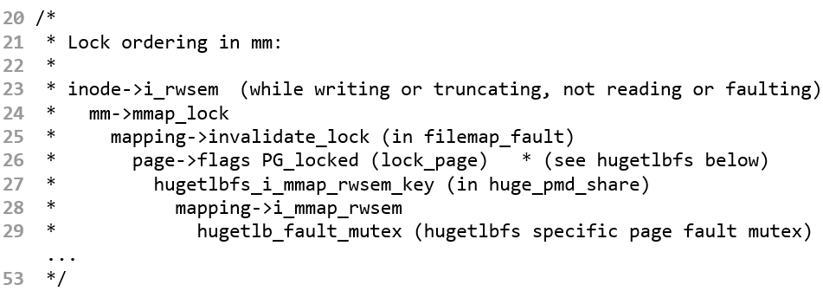
Deadlock (Circular Wait) Prevention on Linux
From linux/mm/rmap.c:
Notes:
Long Description:
The code from top to bottom reads as follows. INFO colon mem cached invoked oom-killer; C P U colon 1 P I D colon 2 8 5 9; Call Trace colon left bracket left angle bracket c 1 0 e l c 1 5 right angle bracket right bracket dump underscore header dot i s r a dot 7 plus 0 x 8 5 forward slash 0 x c 0; left bracket left angle bracket c 1 0 e l e c right angle bracket right bracket oom underscore kill underscore process plus 0 x 5 c forward slash 0 x 8 0; left bracket left angle bracket c 1 0 e 2 2 5 f right angle bracket right bracket out underscore of underscore memory plus 0 x b f forward slash 0 x 1 d e; left bracket left angle bracket c 1 0 f e c 2 c right angle bracket right bracket handle underscore p t e underscore fault plus 0 x e c forward slash 0 x 2 2 0; left bracket left angle bracket c 1 0 f e e 6 8 right angle bracket right bracket handle underscore mm underscore fault plus 0 x 1 0 8 forward slash 0 x 2 1 0; left bracket left angle bracket c 1 5 2 f b 5 b right angle bracket right bracket do underscore page underscore fault plus 0 x 1 5 b forward slash 0 x 4 a 0; left bracket left angle bracket c 1 5 2 c f c f right angle bracket right bracket error underscore code plus 0 x 6 7 forward slash 0 x 6 c; out of memory colon Kill process 2 6 0 3 score 7 6 1 or sacrifice child; Killed colon process 2603 v m colon 1498 M B comma anon-r s s colon 721 M B comma file-rss colon 4 M B.

Slide 54
Deadlock Detection on Linux
Global O O M killer
Resource: memory
Mechanism: explicit detection
Soft lockup detection
Resource: locks
Mechanism: progress tracking
Locking validator
Resource: locks
Mechanism: cycles in the resource allocation graph

Slide 55
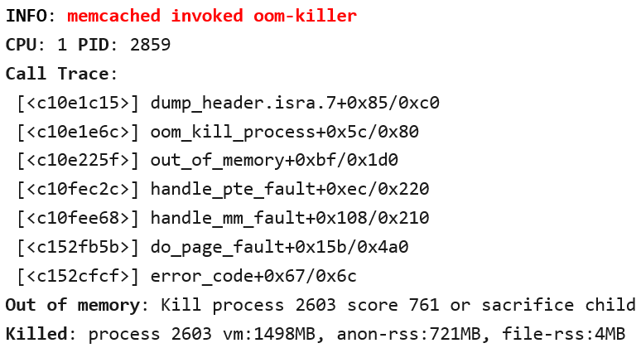
Global O O M Killer on Linux
Notes:
Long Description:
The code from top to bottom reads as follows. INFO colon mem cached invoked oom-killer; C P U colon 1 P I D colon 2 8 5 9; Call Trace colon left bracket left angle bracket c 1 0 e l c 1 5 right angle bracket right bracket dump underscore header dot i s r a dot 7 plus 0 x 8 5 forward slash 0 x c 0; left bracket left angle bracket c 1 0 e l e c right angle bracket right bracket oom underscore kill underscore process plus 0 x 5 c forward slash 0 x 8 0; left bracket left angle bracket c 1 0 e 2 2 5 f right angle bracket right bracket out underscore of underscore memory plus 0 x b f forward slash 0 x 1 d e; left bracket left angle bracket c 1 0 f e c 2 c right angle bracket right bracket handle underscore p t e underscore fault plus 0 x e c forward slash 0 x 2 2 0; left bracket left angle bracket c 1 0 f e e 6 8 right angle bracket right bracket handle underscore mm underscore fault plus 0 x 1 0 8 forward slash 0 x 2 1 0; left bracket left angle bracket c 1 5 2 f b 5 b right angle bracket right bracket do underscore page underscore fault plus 0 x 1 5 b forward slash 0 x 4 a 0; left bracket left angle bracket c 1 5 2 c f c f right angle bracket right bracket error underscore code plus 0 x 6 7 forward slash 0 x 6 c; out of memory colon Kill process 2 6 0 3 score 7 6 1 or sacrifice child; Killed colon process 2603 v m colon 1498 M B comma anon-r s s colon 721 M B comma file-rss colon 4 M B.

Slide 56
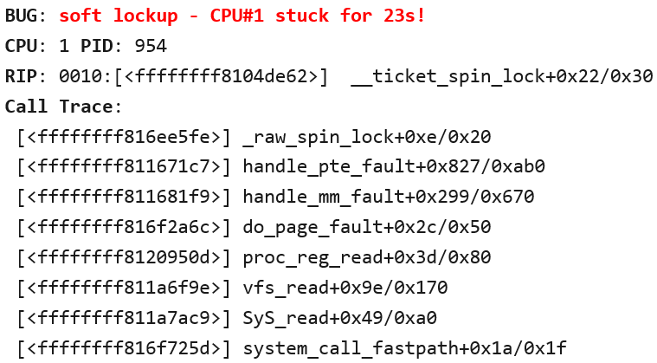
Soft Lockup Detection on Linux
Notes:
Long Description:
The algorithm from top to bottom is as follows BUG colon soft lockup hyphen C P U hashtag 1 stuck for 23 s exclamation mark. C P U 1 P I D colon 954. R I P colon 0010 colon left bracket left angle bracket f f f f f f f f 8 1 0 4 d e 6 2 right angle bracket right underscore ticket underscore spin underscore lock plus 0 x 2 2 forward slash 0 x 3 0. Call Trace colon left bracket left angle bracket f f f f f f f f 8 1 6 e e 5 f e right angle bracket right bracket underscore raw underscore spin underscore lock plus 0 x e forward slash 0 x 2 0 left bracket left angle bracket f f f f f f f f 8 1 1 6 7 1 c 7 right angle bracket right bracket handle underscore p t e underscore fault plus 0 x 8 2 7 forward slash 0 x a b 0; left bracket left angle bracket f f f f f f f f 8 1 1 6 8 1 f 9 right angle bracket right bracket handle underscore mm underscore fault plus 0 x 2 9 9 forward slash 0 x 6 7 0; left bracket left angle bracket f f f f f f f f 81 6 f 2 a 6 c right angle bracket right bracket do underscore page underscore fault plus 0 x 2 c forward slash 0 x 5 0; left bracket left angle bracket f f f f f f f f 8 1 2 0 9 5 0 d right angle bracket right bracket proc underscore reg underscore read plus 0 x 3 d forward slash 0 x 8 0; left bracket left angle bracket f f f f f f f f 8 1 la 6 f g e right angle bracket right bracket v f s underscore read plus 0 x 9 e forward slash 0 x 1 7 0; left bracket left angle bracket f f ff f f f f 8 1 l a 7 a c 9 right angle bracket right bracket SyS underscore read plus 0 x 4 9 forward slash 0 x a 0; left bracket left angle bracket f f f f f f f f 8 1 6 f 7 2 5 d right angle bracket right bracket system underscore call underscore fast path plus 0 x l a forward slash 0 x 1 f.

Slide 57
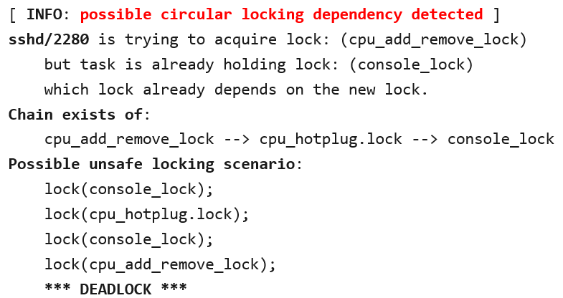
Locking Validator (lockdep) on Linux
Notes:
Long Description:
The code from top to bottom reads as follows. Left bracket INFO colon possible circular locking dependency detected right bracket; s s h d forward slash 2 2 8 0 is trying to acquire lock colon left parenthesis c p u underscore add underscore remove underscore lock end parenthesis, but the task is already holding lock colon left parenthesis console underscore lock right parenthesis which lock already depends on the new lock. Chain exists of colon c p u underscore add underscore remove underscore lock right arrow c p u underscore hot plug dot lock right arrow console underscore lock; Possible unsafe locking scenario colon lock left parenthesis console underscore lock right parenthesis semicolon; lock left parenthesis c p u underscore hotplug dot lock right parenthesis semicolon; lock left parenthesis console underscore lock right parenthesis semicolon; lock left parenthesis c p u underscore add underscore remove underscore lock right parenthesis semicolon; asterisk asterisk asterisk DEADLOCK asterisk asterisk asterisk.

Slide 58

Copyright
This work is protected by United States copyright laws and is provided solely for the use of instructors in teaching their courses and assessing student learning. Dissemination or sale of any part of this work (including on the World Wide Web) will destroy the integrity of the work and is not permitted. The work and materials from it should never be made available to students except by instructors using the accompanying text in their classes. All recipients of this work are expected to abide by these restrictions and to honor the intended pedagogical purposes and the needs of other instructors who rely on these materials.

